Slide 1

CSE347
Information System Analysis and Design
Md Sabbir Hossain
Lecturer
Department of Computer Science and Engineering
Faculty of Science and Engineering

Slide 2
Topic: 7
Class Diagram

Slide 3
OO Structural Modelling
The Static View of a system may be described using UML diagrams:
UML Class Diagrams

Slide 4
Identifying objects
Look for nouns in the SRS (System Requirements Specifications) document
Look for NOUNS in use cases descriptions
A NOUN may be
•
•
Object
Attribute of an object

Slide 5
Identifying Operations ‘methods’
Look for verbs in the SRS (System Requirements Specifications) documen
Look for VERBS in use cases descriptions
A VERB may be
translated to an operation or set of operations
A method is the code implementation of an operation.
5

Slide 6
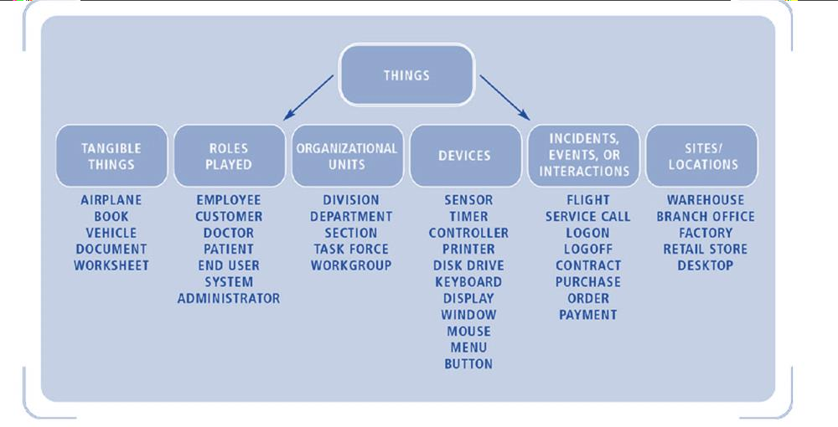
Objects

Slide 7
Class and Class diagram
z Class naming: Use singular names
because each class represents a generalized
version of a singular object.
z Class diagrams are at the core of OO Eng.

Slide 8
Class and Class diagram
Things naturally fall into categories (computers, automobiles, trees...).
We refer to these categories as classes.
An object class is an abstraction over a set of objects with common:
attributes (states)
and the services (operations) (methods)
provided by each object
Class diagrams provide the representations used by the developers.

Slide 9
Class Card Design
ClassName
-attribute1:type +attribute2:type #attribute3:type -attribute4:type -attribute5:type ….. attributen:type
+method1(par1,par2):return type method2(par4,par2):return type -method3(par3,par4):return type #method4(par1,par2):return type …… +methodn(par5,par6):return type
Animal
+species: string -id: int -leg: int -hand: int -tail: boolean +carnivorous: boolean
+eat(carnivorous):string +makeSound(species):string +sleep():void -breed(leg,hand,tail,species):void
Example

Slide 10
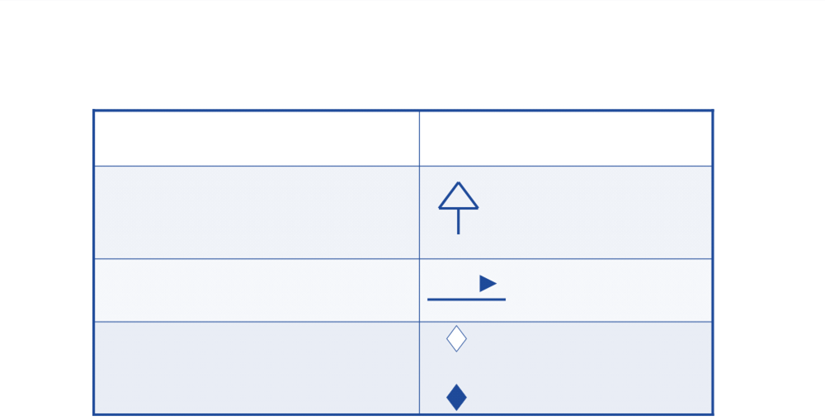
Class diagrams
Shows relationship between classes
A class diagram may show:
Relationship
Generalization (inheritance)
”is a”
“is a kind of”
Association (dependency)
“Who does What” “uses”
“has”
“composed of”
does
Aggregation
Composition: Strong aggregation

Slide 11
Association, aggregation and composition
When considering the 3 relationships, association, aggregation and
composition,
the most general relationship is association,
followed by aggregation
and, finally, composition.

Slide 12
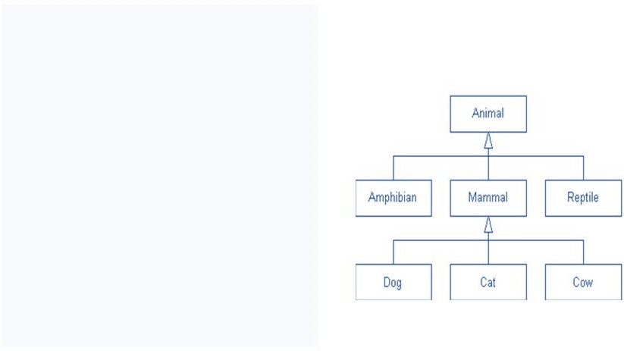
Inheritance: is a“is a kind of”
is a type association.
Child class ‘subclass’ can inherit attributes and operations from parent class 'superclass’.
Example: An inheritance hierarchy in the animal kingdom

Slide 13
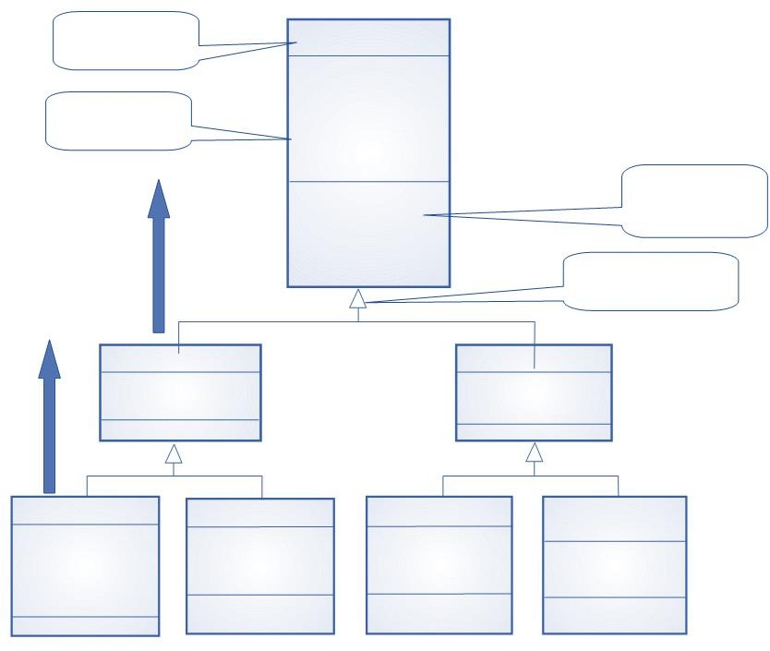
Class name
Library item
Catalogue number Acquisition date Cost
Type
Status
Number of copies
Acquire () Catalogue () Dispose () Issue () Return ()
Attributes
Methods Operations
Library class hierarchy (Library Management System)
Is a
Generalisation
Published item
Recorded item Title
Medium
Is a
Title Publisher
Book
Author Edition
Publication date
ISBN
Magazine
Year Issue
Film
Director
Date of release Distributor
Computer
program
Version Platform

Slide 14
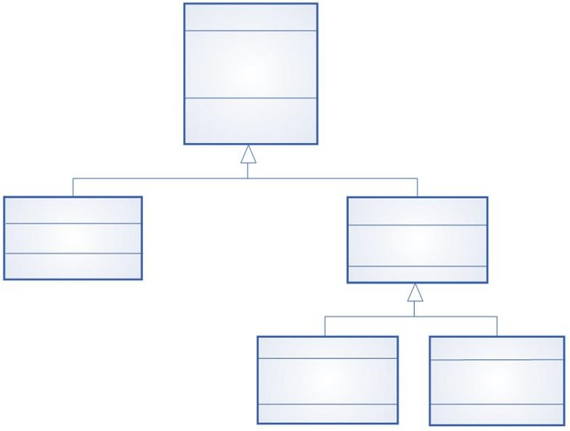
Library user
Name Address Phone Registration #
Register () De-register ()
User class hierarchy (Library Management
System)
Reader Affiliation
Borrower
Items on loan
Max. loans
Staff
Department
Department phone
Student
Major subject
Home address

Slide 15
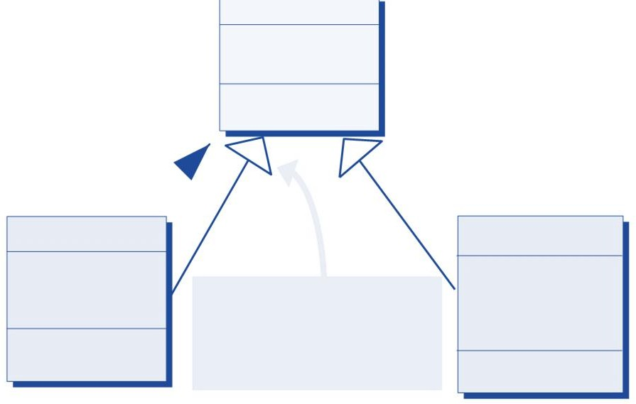
Hierarchy Diagram (UML notation)
PERSON
Name, Address Phone, Sex Date of Birth ChangeAddress
EnquireDOB&Sex
IS A
CUSTOMER
Balance
O/Due 30, 60, 90
Credit Rating Date Paid
CheckCrRating AgeBalances
EMPLOYEE
SIN
Marital Status
No. of Dependants Date Hired
Wage Rate GiveRaise
CalcMonthPay
This kind of arrowhead indicates that this relationship is one of subclassing

Slide 16
Multiple inheritance
Rather than inheriting the attributes and services from a single parent class, a system which supports multiple inheritance allows object classes to inherit from several super-classes
Can lead to semantic conflicts where attributes/services with the same name in different super-classes have different semantics
Makes class hierarchy reorganisation more complex
Java does not support multiple inheritance

Slide 17
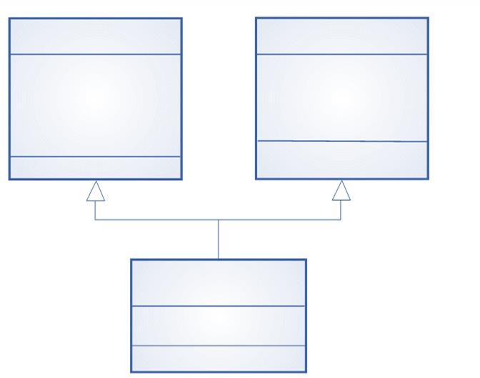
Multiple inheritance Example: The talking book
Book
Author Edition
Publication date
ISBN
Voice recording
Speaker Duration Recording date
Talking book # Tapes

Slide 18
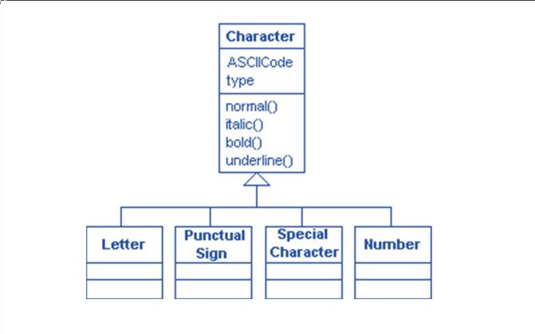
Ex: The character hierarchy
The Characterz class will have ASCIIcode and type as attributes (type tells the type of the character
- normal, italic, bold or underline), and normal(), bold(), italic() and underline() as operations. The Character class children will be: Letter, PunctualSign, SpecialCharacter and Number.

Slide 19
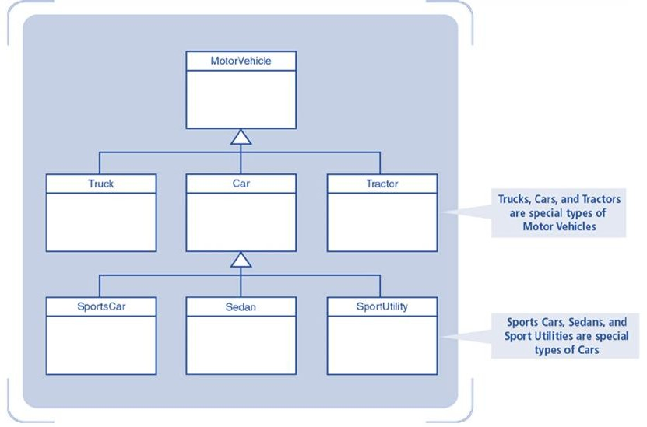
Ex: Generalization/Specialization Hierarchy Notation for Motor Vehicles

Slide 20
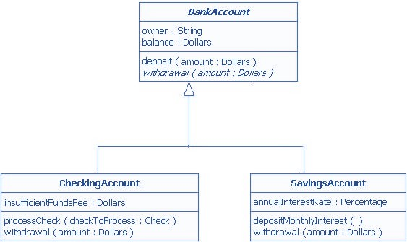
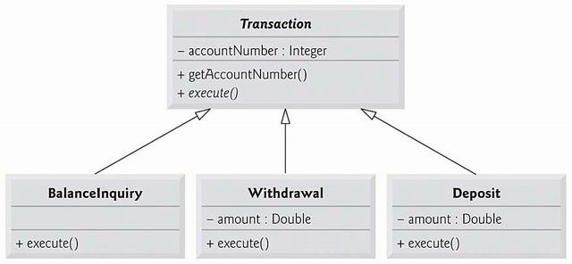
Ex: Generalization/Specialization Hierarchy

Slide 21
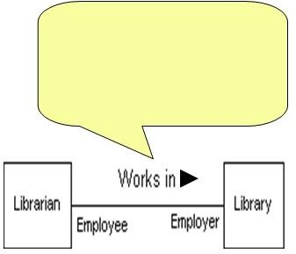
UML: Associations of regular classes
Who does what relationship
When classes are connected together conceptually, that connection is called an association
Association: Who does what
Librarian works in Library

Slide 22
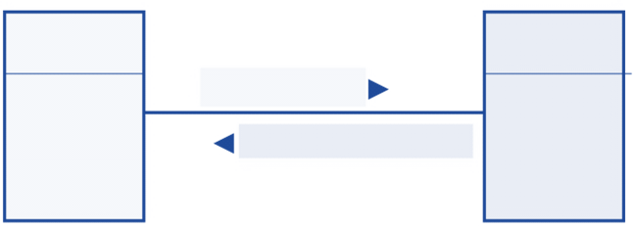
Associations of regular classes - Who does what
A manager supervises 1..* employees
An employee is supervised by 1 manager
Manager
Employee
1
supervises
1..*
is supervised by

Slide 23
Multiplicity of an Association
Shows the number of objects from one class that relate with a number of objects in an associated class.
One class can be relate to another in a:
 one-to-one
 one-to-many
 one-to-one or more
 one-to-zero or one
 one-to-a bounded interval (one-to-two through twenty)
 one-to-exactly n
 one-to-a set of choices (one-to-five or eight)
 The UML uses an asterisk (*) to represent more and to represent many .

Slide 24
OO: Visibility of attributes or operations
Visibility: specifies the extent to which other classes can use a given class's attributes or operations.
Three levels of visibility:
: public level (usability extends to other classes)
: protected level (usability is open only to classes that inherit from original class)
- : private level (only the original class can use the attribute or operation)
• +
#

Slide 25
OO: Visibility
Ex: Public and private operations in a Hard Disk

Slide 26

Object Aggregation
Has-a relationship
Structural: whole/part
Peer relationship
Whole & parts objects can exist independently
A special form of association

Slide 27
Object Aggregation: Peer relationship
Whole & parts objects can exist independently
Example: a bank (whole) has customers (as parts)
Deleting a bank does not cascade deleting customers
Customers can move to another bank
Programming: whole contains an array of parts

Slide 28

Object Aggregation
Aggregation model shows how classes (which are collections) are composed of other classes.
Similar to the part-of relationship in semantic data models.
A line joins a whole to a part (component) with
an open diamond on the line near the whole.

Slide 29
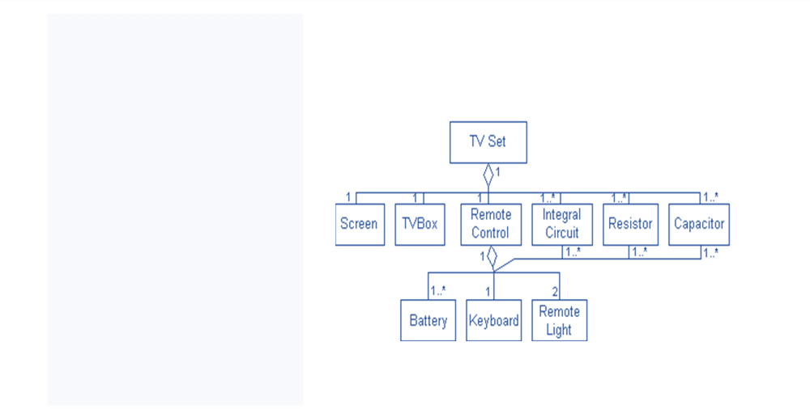
Object Aggregation
Example: An aggregation association in the TV Set system
z Every TV has a TV box, screen, speaker(s), resistors, capatitors, transistors, ICs... and possibly a remote control.
z Remote control can have these parts: resistors, capatitors, transistors, ICs, battery, keyboard and remote lights.

Slide 30
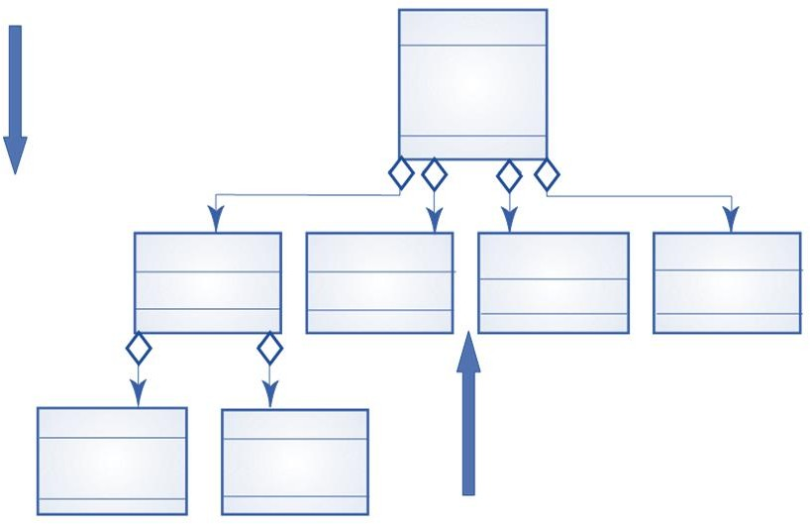
Object aggregation
Study pack
“has” “composed of”
Course title Number Year Instructor
1 1 1
1..*
OHP slides
Slides
1
1
Videotape
1..*
Assignment
14
Lecture notes
Text
Credits
Tape ids.
1
1..3
Exercises
#Problems
Description
1
0..3
Solutions
Text Diagrams
“part of”

Slide 31


Composition
A composite is a strong type of aggregation.
Each component in a composite can belong to just one whole
.
The symbol for a composite is the same as the symbol for an aggregation except the diamond is filled

Slide 32
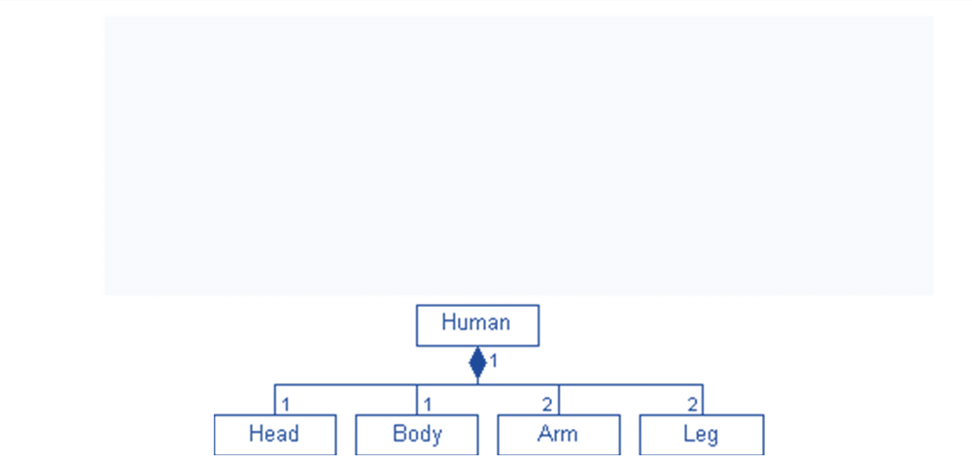
Composition - Example 1
Human's outside:
Every person has: head, body, arms and legs.
A composite association. In this association each component belongs to exactly one whole
.
Whole & parts objects can NOT exist independently

Slide 33
Composition - Example 2
A bank (whole) has many branches (parts)
Branches can not exist independently of the whole (parts objects can NOT exist independently)
Deleting a bank (whole) cascades deleting branches (parts)
But, if a branch (part) is deleted, the bank (whole) may remain

Slide 34
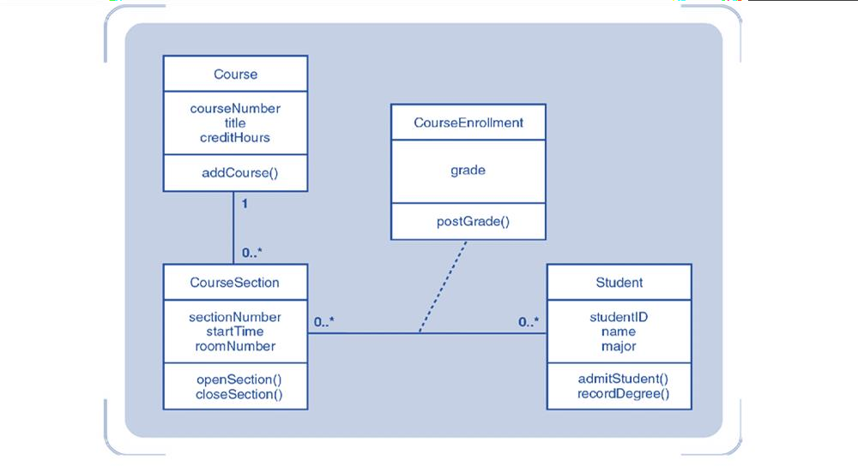
University Course Enrollment Design Class Diagram (With Methods)

Slide 35
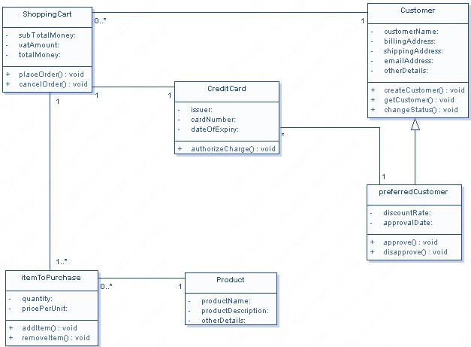
Example:

Slide 36
Exercise
Star Soft Inc. is currently working on the development of an Online House Rental System. The company has gathered requirements and functionalities from stakeholders and is now working on the system design. The system will have two types of users: Owners and Tenants. The database will store the National ID, name, phone number, and email address of both owners and tenants. All users will have to authenticate themselves before accessing the system. They will be able to update their information as per the admin's approval.
Owners will be able to create posts that contain the specifications and pictures of their houses. Each
post will have a unique post ID, owner ID, and content. The admin will review the posts for validity
before approving them. Tenants can search for available houses and view their specifications. These specifications will include information such as the number of rooms, bathrooms, balcony, garage service, elevator service, address, utility bills, service charges, total rent, and owner's contact information.
Both owners and tenants will be able to communicate with each other through messaging. They can also report any incidents to the admin. Finally, the database will store the admin's ID, password, and email
address.

